Slide 1
Functions in Excel

Slide 2
Count and Sum functions

Slide 3
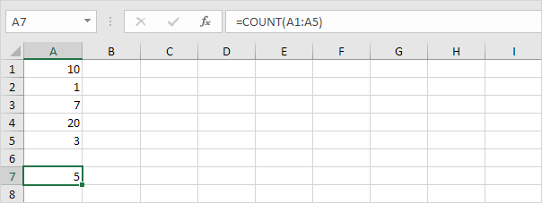
Count
To count the number of cells that contain numbers, use the COUNT function.

Slide 4
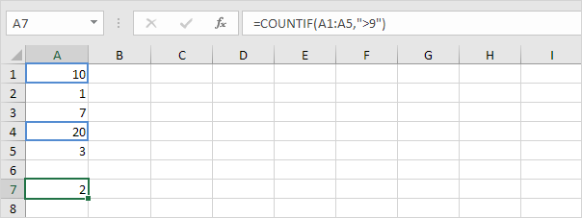
Count IF
To count cells based on one criteria (for example, greater than 9), use the following COUNTIF function.

Slide 5
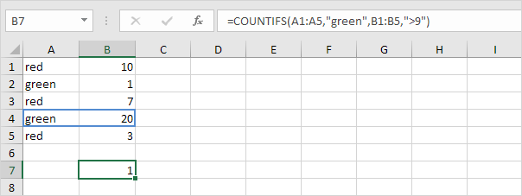
Countifs
To count cells based on multiple criteria (for example, green and greater than 9), use the following COUNTIFS function.

Slide 6
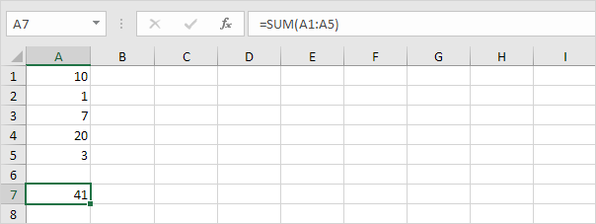
Sum
To sum a range of cells, use the SUM function.

Slide 7
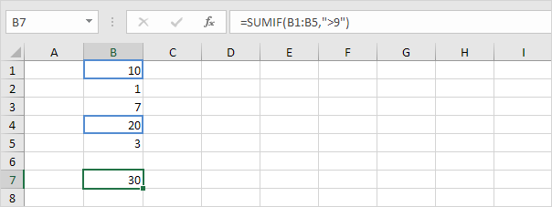
Sumif
To sum cells based on one criteria (for example, greater than 9), use the following SUMIF function (two arguments).

Slide 8
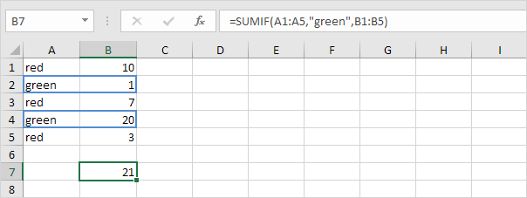
Cont...
To sum cells based on one criteria (for example, green), use the following SUMIF function (three arguments, last argument is the range to sum).

Slide 9
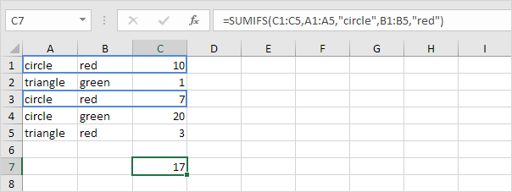
Sumifs
To sum cells based on multiple criteria (for example, circle and red), use the following SUMIFS function (first argument is the range to sum).

Slide 10
Text Functions

Slide 11
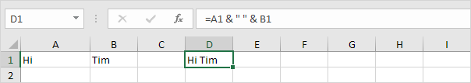
Join Strings
To join strings, use the “&” operator.

Slide 12
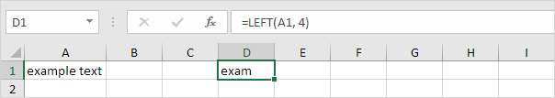
Left
To extract the leftmost characters from a string, use the LEFT function.

Slide 13
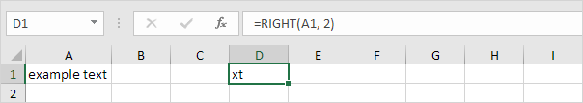
Right
To extract the rightmost characters from a string, use the RIGHT function.

Slide 14

Mid
To extract a substring, starting in the middle of a string, use the MID function.

Slide 15
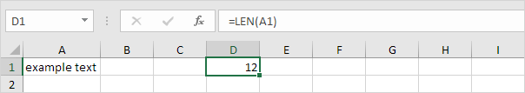
Len
To get the length of a string, use the LEN function.

Slide 16

Find
To find the position of a substring in a string, use the FIND function.

Slide 17
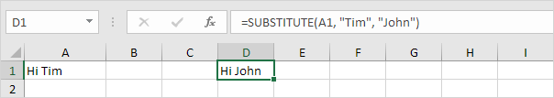
Substitute
To replace existing text with new text in a string, use the SUBSTITUTE function.

Slide 18
Information functions

Slide 19
Numerical Information Functions
ISNUMBER | Tests if a supplied value is a number, and if so, returns TRUE; Otherwise, returns FALSE.
ISEVEN | Tests if a supplied number (or expression) is an even number, and if so, returns TRUE; Otherwise, returns FALSE.
ISODD | Tests if a supplied number (or expression) is an odd number, and if so, returns TRUE; Otherwise, returns FALSE.
N | Converts a non-number value to a number, a date to a serial number, the logical value TRUE to 1 and all other values to 0

Slide 20
Error Information Functions
ISERROR | Tests if an initial supplied value (or expression) returns an error and if so, returns TRUE; Otherwise returns FALSE
ISERR | Tests if an initial supplied value (or expression) returns an error (EXCEPT for the #N/A error) and if so, returns TRUE; Otherwise returns FALSE
ISNA | Tests if an initial supplied value (or expression) returns the Excel #N/A error and if so, returns TRUE; Otherwise returns FALSE
ERROR.TYPE | Tests a supplied value and returns an integer relating to the supplied value's error type

Slide 21
Other Data Type Functions
ISBLANK | Tests if a supplied cell is blank (empty), and if so, returns TRUE; Otherwise, returns FALSE
ISLOGICAL | Tests if a supplied value is a logical value, and if so, returns TRUE; Otherwise, returns FALSE
ISTEXT | Tests if a supplied value is text, and if so, returns TRUE; Otherwise, returns FALSE
ISNONTEXT | Tests if a supplied value is text, and if it is NOT, returns TRUE; Otherwise, returns FALSE
ISREF | Tests if a supplied value is a reference, and if so, returns TRUE; Otherwise, returns FALSE
ISFORMULA | Tests if a supplied cell contains a formula and if so, returns TRUE; Otherwise, returns FALSE
TYPE | Returns information about the data type of a supplied value

Slide 22
General Information Functions
CELL | Returns information about the contents, formatting or location of a given cell
SHEET | Returns the sheet number relating to a supplied reference (New in Excel 2013)
SHEETS | Returns the number of sheets in a reference (New in Excel 2013)
INFO | Returns information about the current operating environment

Slide 23
type_text | Information Returned
"directory" | Path of the current directory
"numfile" | The number of active worksheets in all currently open Excel Workbooks
"origin" | Returns the top left cell reference of the current worksheet (generally A1) and the top left cell that is currently visible in the scrolled area of the current worksheet.
"osversion" | Current operating system version
"recalc" | Current recalculation mode (either "Automatic" or "Manual")
"release" | Current version of Microsoft Excel
"system" | Current operating environment ("mac" = Macintosh or "pcdos" = Windows)

Slide 24
Function Returning a Constant Value
NA | Returns the Excel #N/A error

Slide 25
Volatile Function
A Volatile Function is one that causes recalculation of the formula in the cell where it resides every time Excel recalculates. This occurs regardless of whether the precedent data and formulas on which the formula depends have changed, or whether the formula also contains non-volatile functions.
Avoid volatile functions wherever possible. You can make a User-Defined Function volatile by including Application. Volatile in the function code.

Slide 26
Excel’s Volatile Functions.
Some of Excel’s functions are obviously volatile: RAND(), NOW(), TODAY()
Others are less obviously volatile:
CELL(), INFO()
Some are volatile in some versions of Excel but not in others: INDEX()became non-volatile in Excel 97.
A number of functions that are documented by Microsoft as volatile do not actually seem to be volatile when tested:
INDEX(), ROWS(), COLUMNS(), AREAS()

Slide 27
LOOKUP and REFERNCE FUNCTIONS

Slide 28
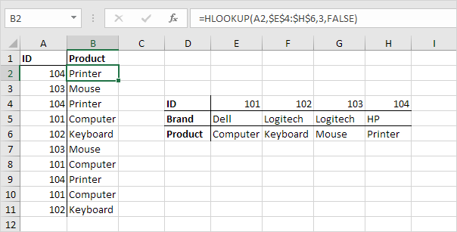
Hlookup
In a similar way, you can use the HLOOKUP (Horizontal lookup) function.

Slide 29
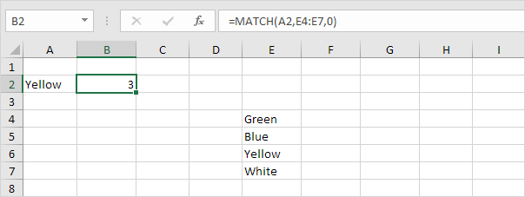
Match
The MATCH function returns the position of a value in a given range.

Slide 30
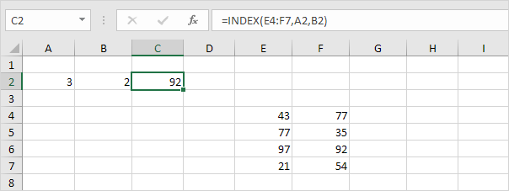
Index
The INDEX function below returns a specific value in a two-dimensional range.

Slide 31
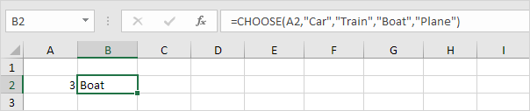
Choose
The CHOOSE function returns a value from a list of values, based on a position number.

